Slide 1
Notes: I changed items in green on next pages.
I don’t understand what many of the other changes are.
Changes for Pathfinder
KR Conversation Guide Branding: Add Pathfinder “brand” at the top left of the page using the J&J font in all caps. What is this? Pathfinder on left in all caps.
Branding - Center Kinematic Restoration Conversation Guide in the middle of the header. Use pathfinder image provided in shared images.
Intro Text Update: Update the intro text to: “The Pathfinder Kinematic Restoration Conversation Guide will help…”
Landing Page: Suggest creating a landing page video or graphic to enhance engagement. Use photos on shared drive.
Disclaimers: Add standard legal disclaimers and copyright (© Johnson & Johnson, [Year]) at the bottom. On all pages and downloadable form.
Glossary Terms: Move “Anatomy” and similar glossary terms to the upper right of the rectangular space. See Page 5.
Editable Fields: Include the ability to edit/change certain “conversation” details (e.g., surgeon name) after initial creation. Likes idea of buttons on cards. Edit, Load, …etc. See page 4.
Alignment Philosophy Scores:
Current visuals seem a bit scattered. We would like for the guide to show a clear tendency towards a specific alignment philosophy. Is there a more intriguing way to display this? If not, it is ok.
Brainstorm alternative visuals – maybe a larger “dot” indicating the direction, not just on hover. If there is a way to explore other charts, he would like to. This was David’s comment and not his.
Color Guidelines: Avoid using orange. Stick with dominant J&J colors — primarily red with supporting tones from the J&J color palette. Colors are good on page 3. Keep light colors as is on References and Citations page for now.
PDF Layout Improvements: For downloadable PDFs, move alignment philosophy abbreviations (e.g., KA) to the far right for cleaner presentation. Done. Don’t worry about this. You already did it.
When creating a new conversation, users currently need to select a “Current Alignment Philosophy.” Could we please add an option for “Unknown” to account for situations where that information isn’t available? Rob will do.
We’ll need to update the questions to match those in the attached PowerPoint. The correct scoring is listed in the notes section of each slide. Apologies, I had thought the updated version had already been shared. James will send final questions.
Would it be possible for the sales consultant to review all questions and answers at the end of the conversation? This would be helpful for quick reference and reinforcement. Can they see the questions? After completed, can we review questions? And review it in the pdf? I am not sure where this would go. Is it possible to add the entire conversation in the window that says Edit Notes? The conversation could appear at the top and below is a section to write notes?See page 6.
Can we add a “Download Conversation” button that would allow the user to export the conversation as a PDF?

Slide 2
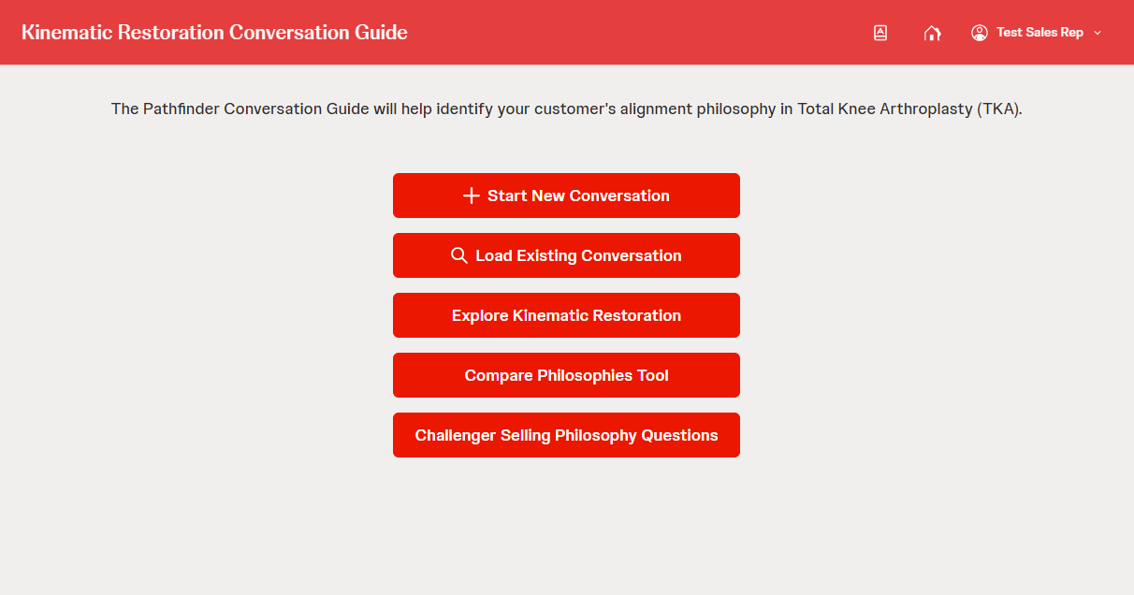
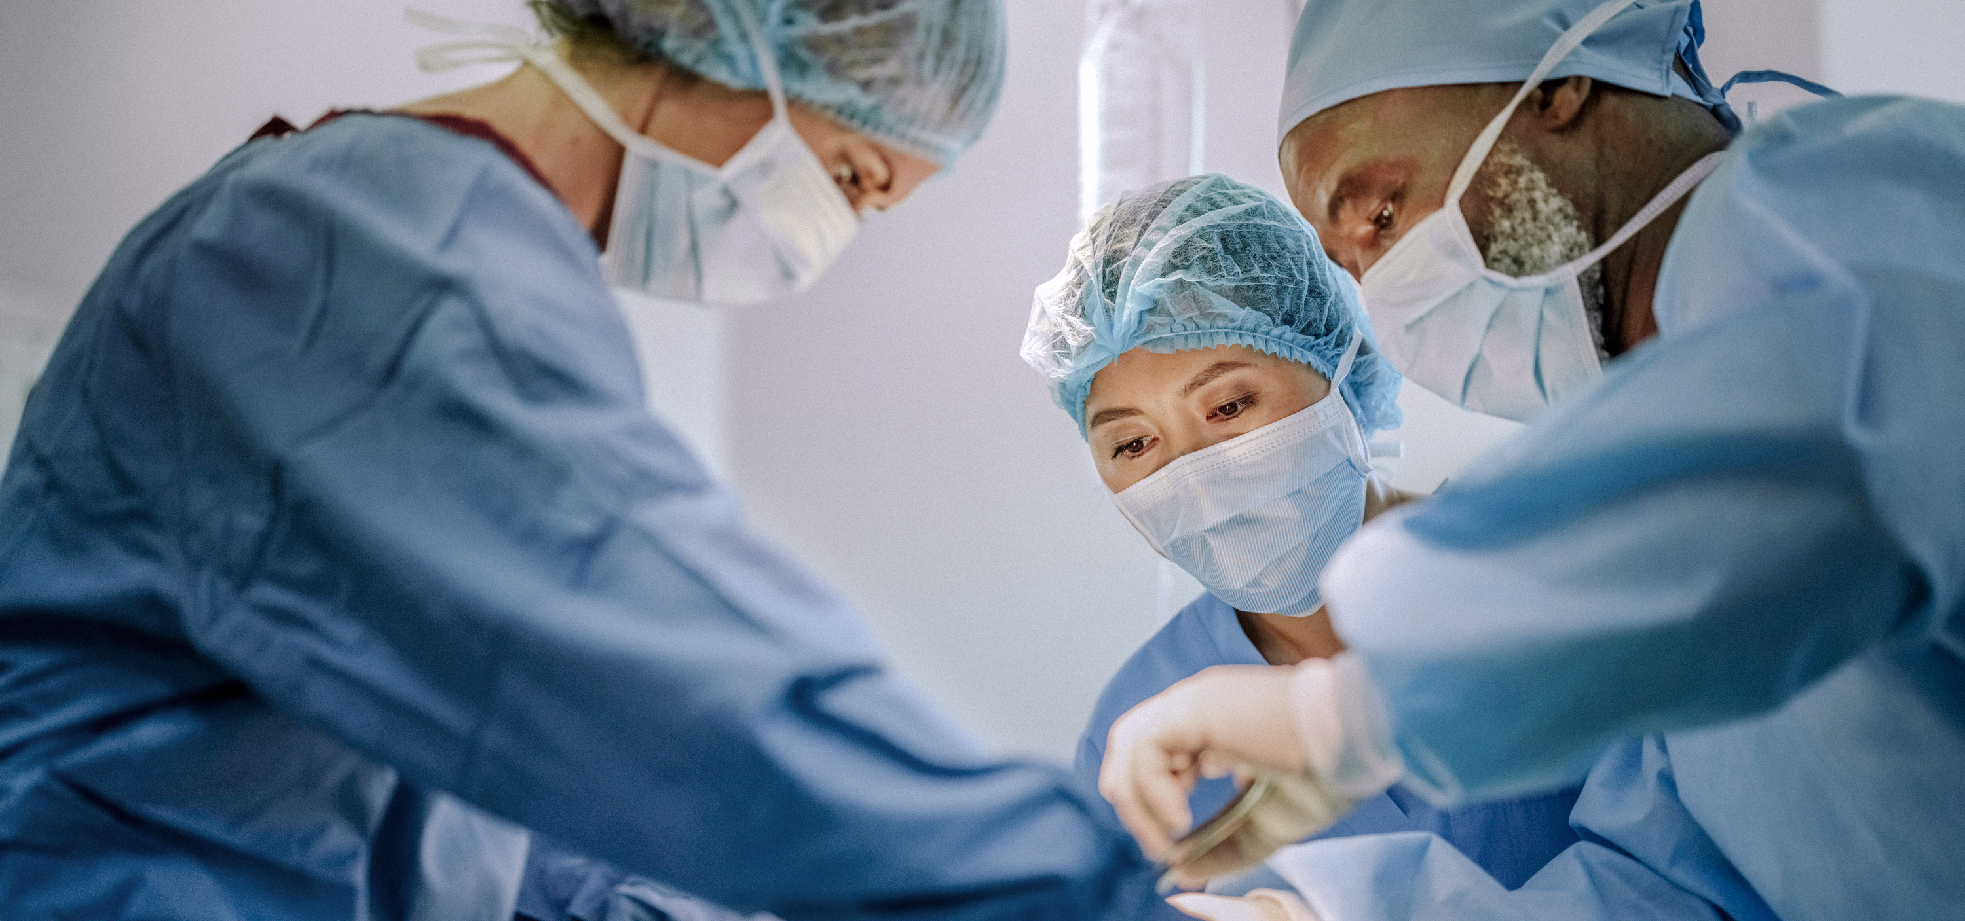
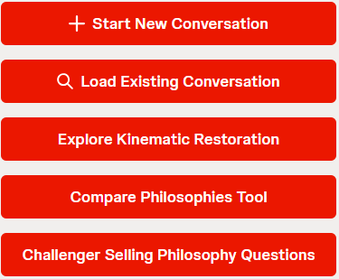

OPTION 1
Added confidentiality and copyright at bottom.
Centered title.
Added photo behind links but had to move the links so that knee could be seen.
We could add video and then this appears on top?
PATHFINDER Kinematic Restoration Conversation Guide
The Pathfinder Kinematic Restoration Conversation Guide will help you identify your customer’s alignment philosophy in Total Knee Arthroplasty (TKA).
© Johnson & Johnson and its affiliates. 2024. All rights reserved.
CONFIDENTIAL. FOR INTERNAL USE ONLY. NOT FOR USE WITH ANY CUSTOER OR FOR EXTERNAL DISTRIBUTION.

Slide 3
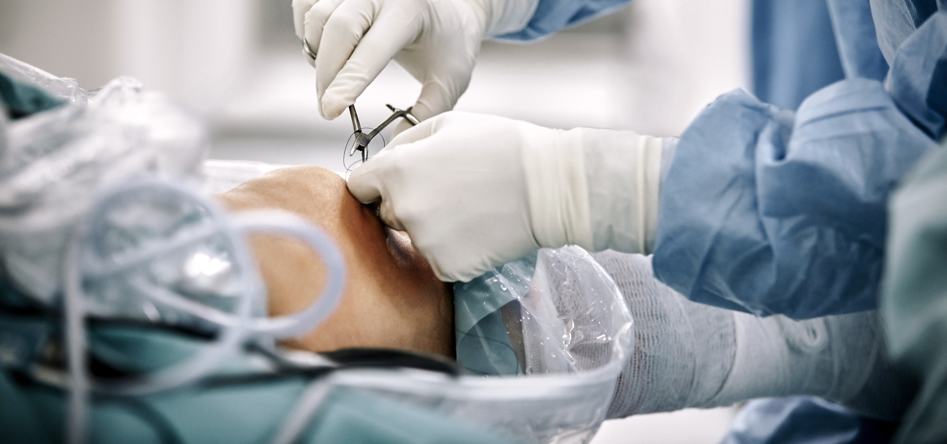
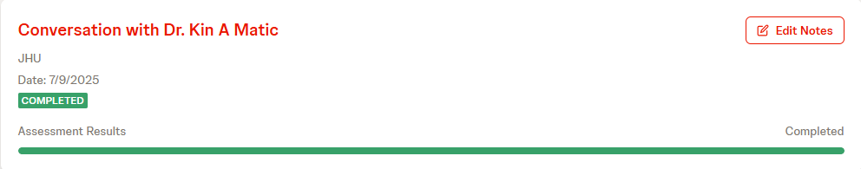

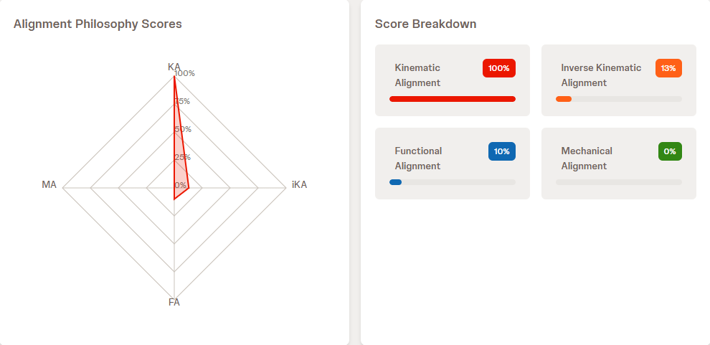
OPTION 1 – page 2
Left photo behind.
Moved completion feedback up and changed color to green.
Moved Approach text to left and added image placeholder. Henry is creating images.
Changed colors in lower right.
PATHFINDER Kinematic Restoration Conversation Guide
Assessment completed! Your recommended alignment philosophy has been determined.
Image
Your Approach Suggests:
Kinematic Alignment (KA) prioritizes restoring the native joint line. The femur is resurfaced first. Next, the tibia is resurfaced. Femoral and tibial resection depths are planned as the implant thickness minus the estimated cartilage and bone wear values.
KINEMATIC ALIGNMENT
© Johnson & Johnson and its affiliates. 2024. All rights reserved.
CONFIDENTIAL. FOR INTERNAL USE ONLY. NOT FOR USE WITH ANY CUSTOER OR FOR EXTERNAL DISTRIBUTION.

Slide 4
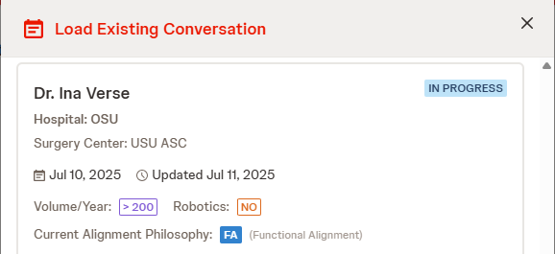
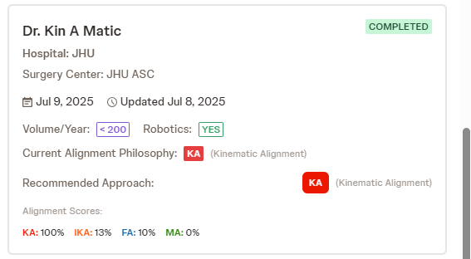
Load Conversation
Edit Conversation
Load Conversation

Slide 5
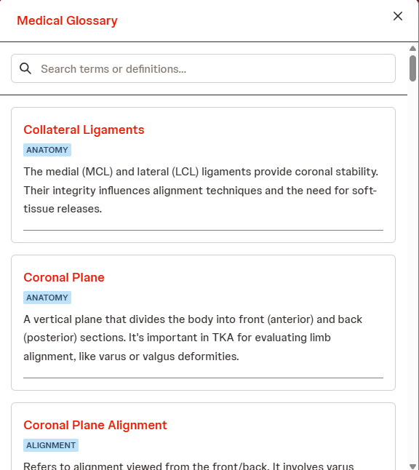
Move light blue text to the upper right of each definition.

Slide 6
PATHFINDER Kinematic Restoration Conversation Guide
Review Conversation
Assessment completed! Your recommended alignment philosophy has been determined.
Image
Your Approach Suggests:
Kinematic Alignment (KA) prioritizes restoring the native joint line. The femur is resurfaced first. Next, the tibia is resurfaced. Femoral and tibial resection depths are planned as the implant thickness minus the estimated cartilage and bone wear values.
KINEMATIC ALIGNMENT
© Johnson & Johnson and its affiliates. 2024. All rights reserved.
CONFIDENTIAL. FOR INTERNAL USE ONLY. NOT FOR USE WITH ANY CUSTOER OR FOR EXTERNAL DISTRIBUTION.

Slide 7
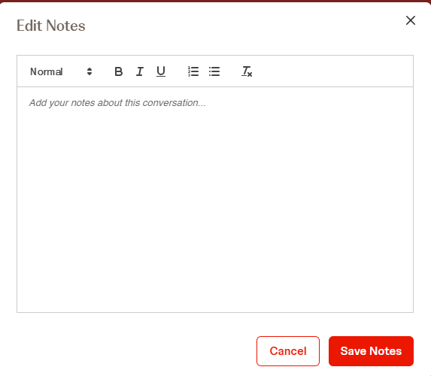
PATHFINDER Kinematic Restoration Conversation Guide
Review Conversation with Asas
Review Conversation
Are you willing to deviate from mechanical axis (0 HKA)? Yes
What is your primary goal…. Answer
Question Yes
Question Answer
Question Yes
Question Answer
Assessment completed! Your recommended alignment philosophy has been determined.
Image
Your Approach Suggests:
Kinematic Alignment (KA) prioritizes restoring the native joint line. The femur is resurfaced first. Next, the tibia is resurfaced. Femoral and tibial resection depths are planned as the implant thickness minus the estimated cartilage and bone wear values.
KINEMATIC ALIGNMENT
Add additional notes about the conversation.
© Johnson & Johnson and its affiliates. 2024. All rights reserved.
CONFIDENTIAL. FOR INTERNAL USE ONLY. NOT FOR USE WITH ANY CUSTOER OR FOR EXTERNAL DISTRIBUTION.

